Slide 2
EEO Risks
Federal and State EEO laws not suspended in COVID-19 era
Heightened concerns re ADA (disability discrimination)
Heightened risks of age and national origin discrimination
ADA medical confidentiality rules still apply
Employer rights for medical exams are broader in a pandemic
Employees with chronic health conditions entitled to accommodations due to heightened risk
Leave beyond FFCRA may be a reasonable accommodation

Slide 3
Privacy issues
Privacy Issues Will Be Prominent Moving Forward
Enormous amounts of data will likely be collected as part of reopening procedures.
Data likely to be collected include:
Temperatures of visitors/guests/customers
Observations regarding behavior/actions of the same
Similar biometric data to measure enforcement and effectiveness of social distancing measures
Collection of identification data may be needed as well for “contact tracing” purposes

Slide 4
Potential pitfalls
Data Collection
Increasing numbers of states expanding the definition of “personal” information:
California Consumer Privacy Act
NY SHIELD law
In those states, “personal information” much broader than before:
Includes biometric data, which is being defined very broadly
Failure to obtain consent, properly protect, or even delete information could lead to claims of privacy violations

Slide 5
Privacy Protection
Considerations
First and foremost, do not store or retain data unless absolutely necessary
If you do collect data, make sure to follow applicable state regulations, including on:
Consent
Protection of data
Required disclosures
Obligations regarding sharing or deletion of data
Note that there are some federal bills proposing liability exemption for privacy violations, but passage is not certain.

Slide 6
The Legal Landscape
After September 11, 2001 (1 of 2)
Claims filed against Port Authorities, security companies, Boeing and others.
Defendants sought dismissal, arguing no duty to Plaintiffs existed because Defendants could not have reasonably anticipated the actions of the terrorist.
District Court found that:
Airlines and security companies have a duty to secure against terrorists.
Terrorist hijacking was a foreseeable hazard.
Failure of manufacturers to design impenetrable cockpit door was a proximate cause of crashes.
The danger of a plane crashing as a result of a hijacking was “the very risk that Boeing should reasonably have foreseen.”
In re September 11 Litigation, 280 F.Supp.2d 279 (S.D.N.Y. 2003)

Slide 7
The Legal Landscape
After September 11, 2001 (2 of 2)
Litigation against Port Authority of New York and New Jersey related to 1993 World Trade Center bombing.
Plaintiffs argued that Port Authority negligently failed to provide adequate security.
Jury found Port Authority partly liable.
Appellate Court affirmed verdict, holding defendant had duty to provide “reasonable” mitigation measures.
Decision overturned by NY Court of Appeals on sovereign immunity grounds, not on whether the terrorist threat was foreseeable.
“The jury had before it evidence that the risk reasonably to be perceived by defendant was of an event potentially monstrous . . . And, in view of the extensive nature of foreseeable harm, it would appear indisputable that the jury could have fairly concluded that [defendant failed to] reasonably minimize the risk of harm . . . .”
Nash v. Port Auth. of NY and NJ, 51 A.D.3d 337 (N.Y. App. Div. 2008), overruled by
In the Matter of World Trade Center Bombing Litig. V. Port Auth. Of NY and NJ, 957 N.E.2d 733 (N.Y. 2011)

Slide 8
Liability protections
Are Liability Protections Available?
One of the hottest topics associated with the pandemic
Medical malpractice liability laws passed in New York, New Jersey, Michigan
HOWEVER, no general liability protection laws passed as of yet
Congress currently debating liability protection statute:
Senate Majority Leader has labeled it a “Red Line” for the next stimulus bill

Slide 9
Liability statute
Will Existing Liability Statute Help?
PREP Act?
Possibly: covers FDA approved/regulated drugs and biologics
Also applies to medical devices and respirators
It provides immunity for dispensing/deployment of covered items, so there could be liability protections for security officers dispensing PREP Act covered products.
SAFETY Act?
Only applies for terrorism
BUT, could be used as a factual defense regarding policies and procedures to manage facilities, guests, and employees during pandemic situation.

Slide 10
Applying the safety act
Applying the SAFETY Act To Push Back
Acting on public health information
A SAFETY Act application can cover your policies, procedures, and process for deciding whether to act upon information.
Reasonable measures to screen for persons infected with COVID-19
The SAFETY Act Office regularly reviews and deems effective screening procedures, including for people exhibiting behavior indicative of illness/injury.
“Failure to follow proper incident response procedures”
Same thing here – incident response procedures are a basic component of SAFETY Act submissions
SAFETY Act makes it easier to push back against claims

Slide 12
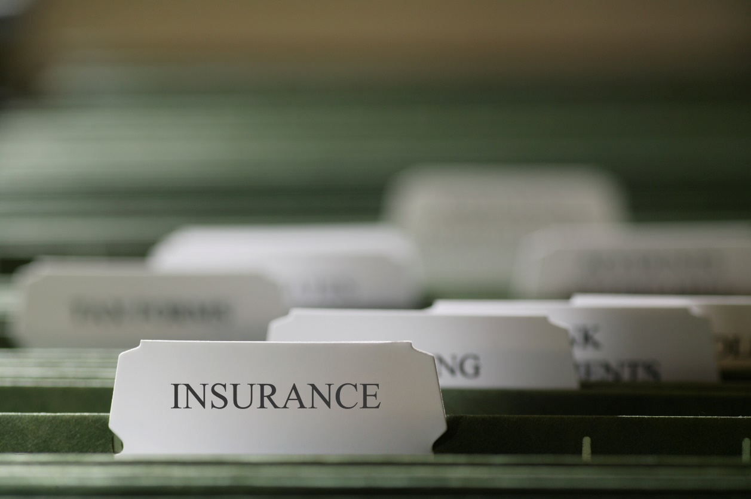
Impact of Insurance
A Primer on Insurance
First Party vs. Third Party Coverages
Third Party insurance discussed later
Event Cancellation
Coverages available before 1/24/20 and after
Types of Damages covered

Slide 13
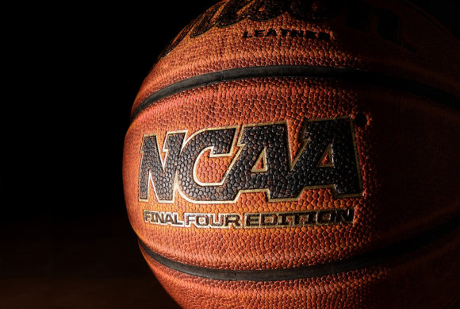
Impact of Insurance
Types of Insurance Coverages (Cont’d)
Business Interruption Insurance (aka Time Element Coverage)
Civil Authority
Ingress/Egress
Physical Loss or Damage
Types of damages covered

Slide 14
Impact of Insurance
Insurance Purchased By Individual Converences
Big East and Atlantic 10 EC policies for conference basketball tournaments
Pro sports policies (e.g., Wimbledon & British Open)

Slide 15
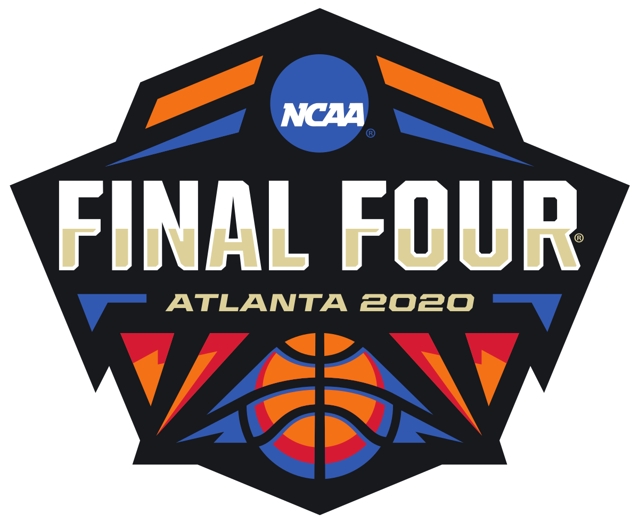
Impact of Insurance
The NCAA’s Insurance Program for 2020 March Madness
The NCAA’s event cancellation insurance policy is the primary reason a $225 million distribution is possible
Discuss NCAA event cancellation insurance issues; e.g., why the policy limits weren’t higher for a $900 million event

Slide 16
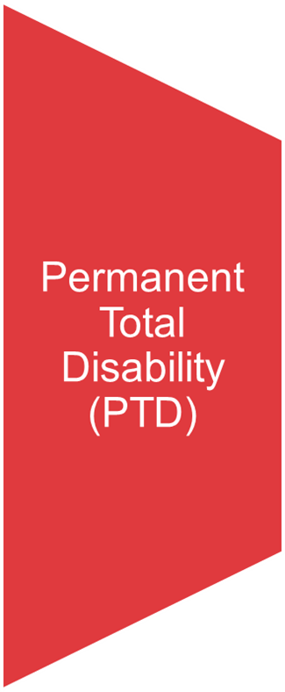
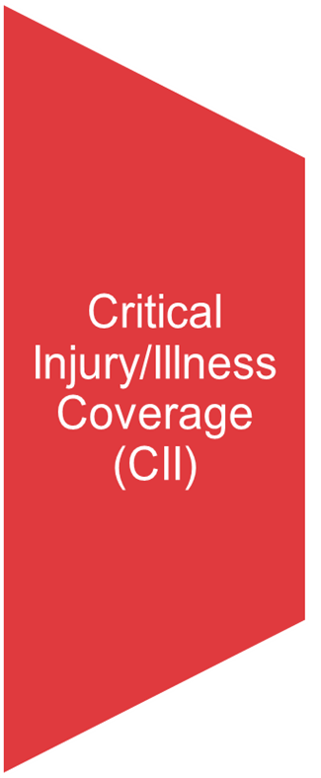
future impact on insurance
Student Assistance Fund (SAF) Implications
Impact of the NCAA allowing schools to use SAF monies to pay for increased scholarship positions and reduction in athlete insurance premium payments

Slide 17
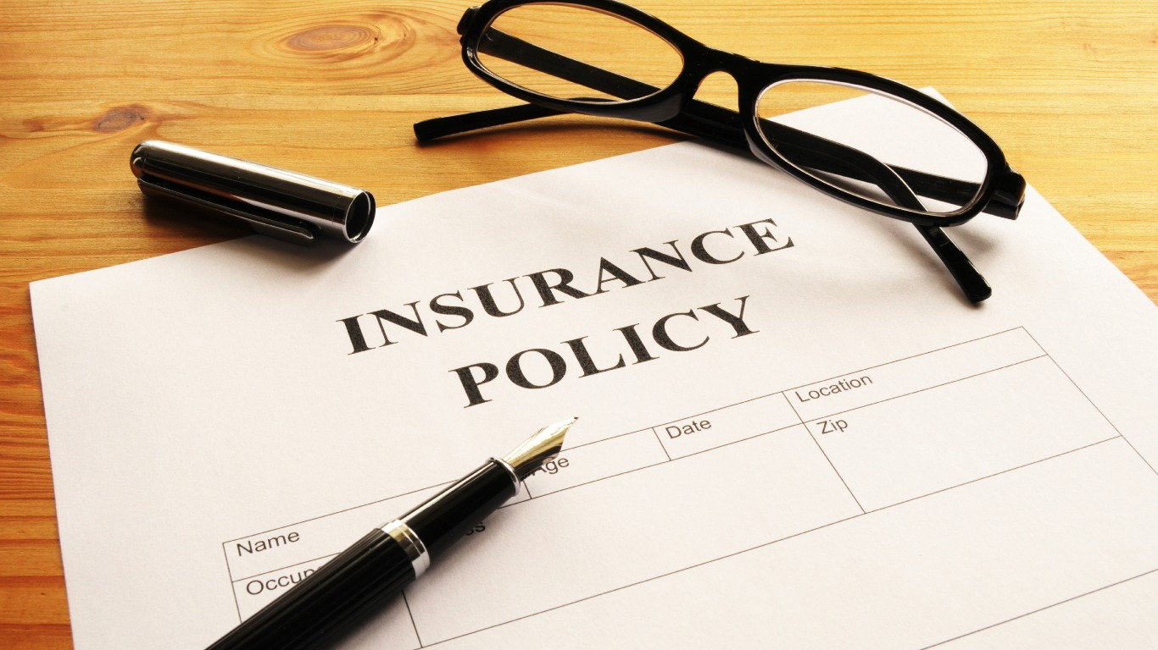
future impact on insurance
Future Insurance Implications
Event Cancellation Insurance, Business Interruption Insurance and other risk shifting mechanisms
Harder to secure and more expensive to purchase

Slide 19
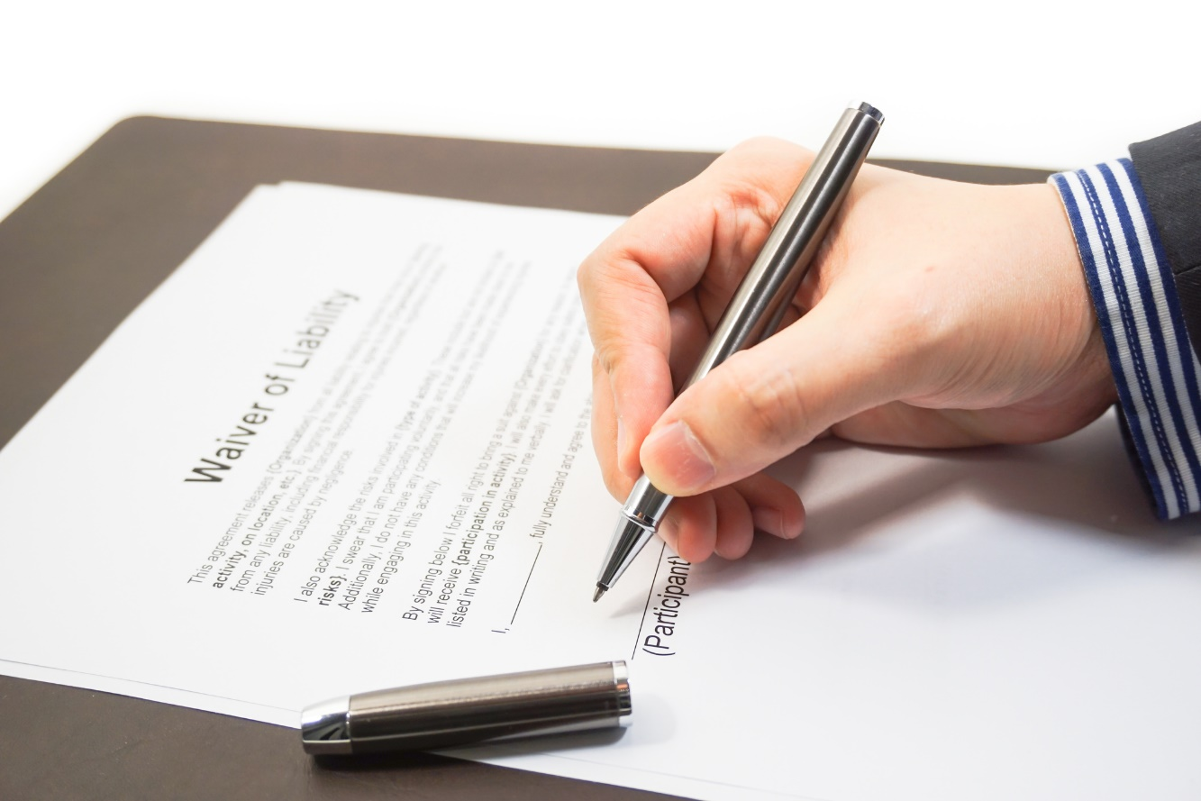
Legal implications of return
Protection Against COVID-19 Lawsuits (1 of 2)
Risk Mitigation Ideas
Third Party Insurance (General Liability)
Waivers
Employees
Fans
Establishing re-opening guidelines

Slide 20
Legal implications of return
Protection Against COVID-19 Lawsuits (2 of 2)
Possible Legal Immunity from Liability
Federal and State Legislative efforts
14 College Presidents met with VP Pence and Ed. Sec. DeVos to talk about re-opening
Immunity was a big topic of discussion
Differing views on Immunity/Safe Harbor
Democrats
Republicans
Gross Negligence, Willful Misconduct, or intentional harm

Slide 21
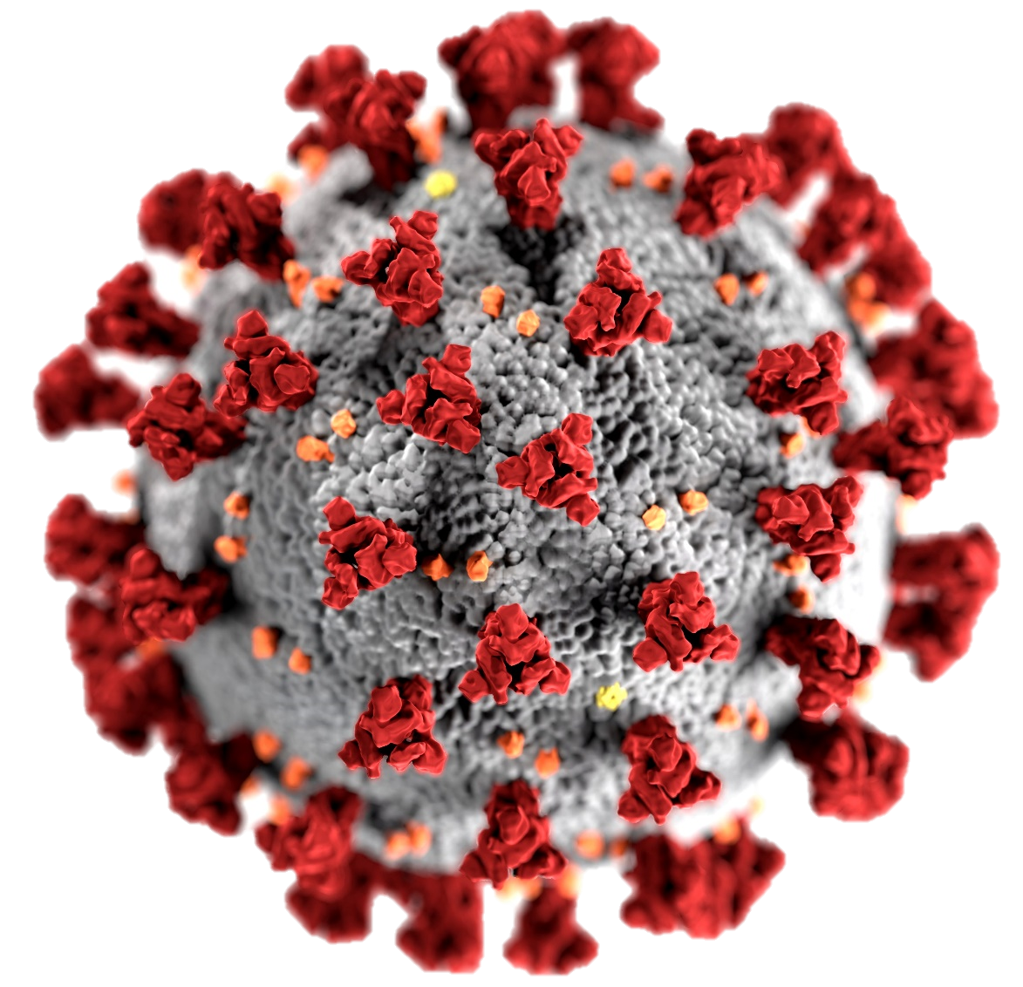
Legal implications of return
Complying with Health Suggestions
CDC Requirements https://www.cdc.gov/coronavirus/2019-ncov/downloads/php/CDC-Activities-Initiatives-for-COVID-19-Response.pdf
COVID-19 Testing
Issues re: testing athletes vs. general public
Tracking -- Privacy implications
Social Distancing
Masks, temperature taking, etc.

Slide 22
Legal implications of return
Limiting Fan Interaction/Autographs
Pro sport recommendations
Other fan interactions
Short term elimination of established college traditions
The Baylor Line or Wildcat Walk (UofA), UCLA’s Bruin Walk, Ole Miss’ Walk Through the Grove

Slide 23
Legal implications of return
Impact of Differing State Regulations
Calif. Gov. Gavin Newsom announced on 3/30 that mass gatherings are “not in the cards” in Calif. until 2021 even after lockdown lifted
What’s the impact on college football and basketball practices and games for California schools
What are the implications of playing games outside of California
Implications of complying with federal orders but violating state or local orders?

Slide 24
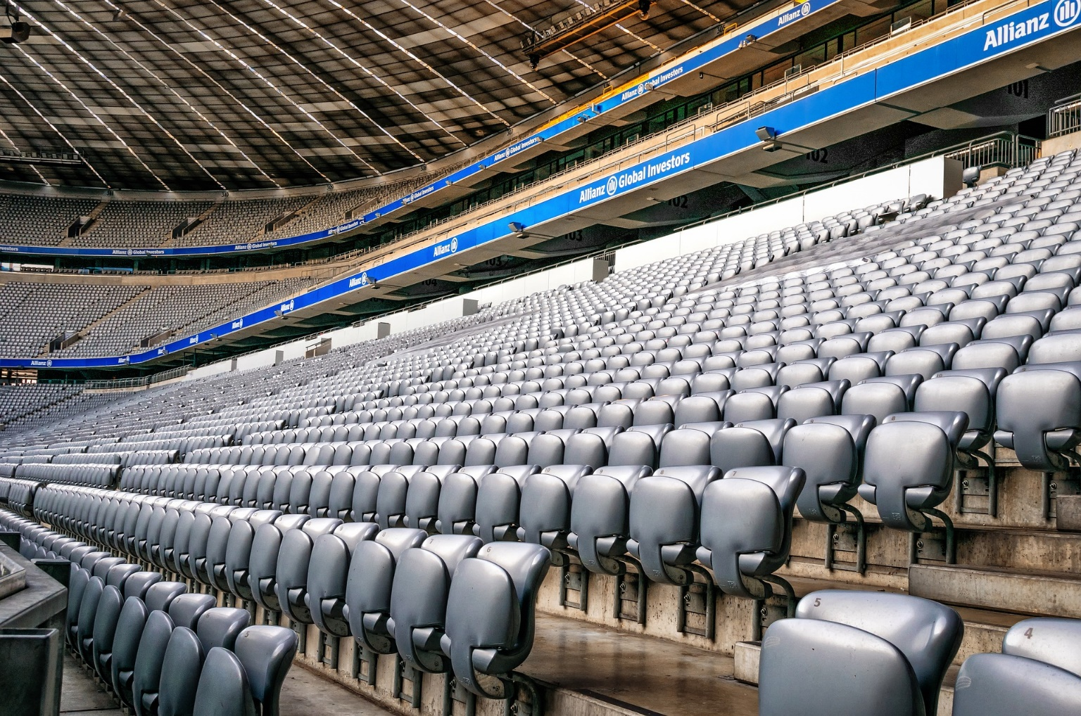
Legal implications of return
Sports Scheduling Issues
Schools may be forced to only schedule nearby opponents
Impact on traditional rivalries and contractual limitations/issues
Games with no fans

Slide 25
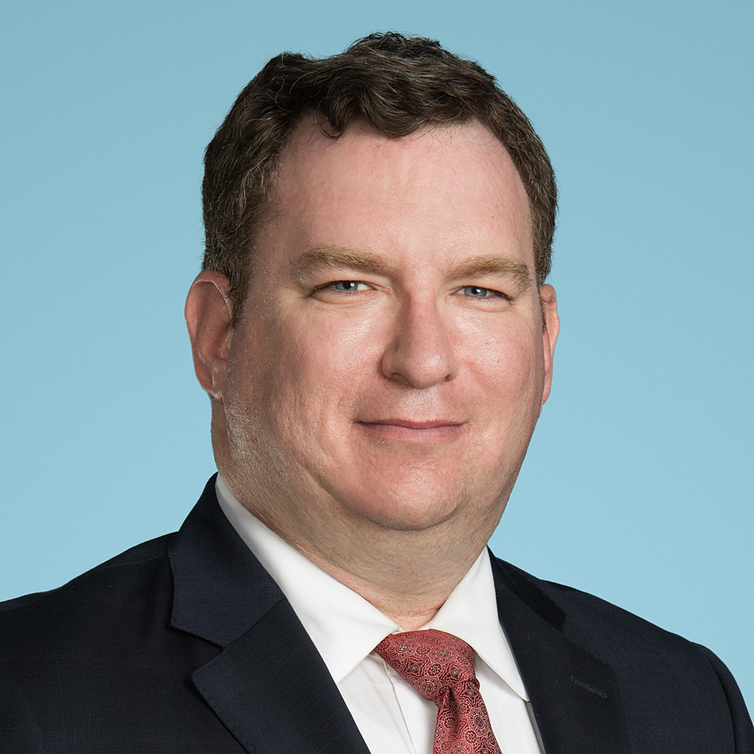
Brian Finch
202-663-8062
brian.finch@pillsburylaw.com
Richard Giller
213-488-3624
Richard.giller@pillsburylaw.com

